Slide 2

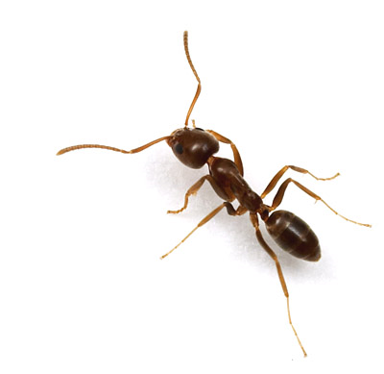
Objectives
Simulate a complete day
Model all tasks
Model recruitment rates to each task
Interactions
Environmental stimuli

Slide 3
Fundamental Limitations
Inconsistency in the research
Convening?
Forager food-source fidelity?
Gaps in research
How do ants transfer information?
Cuticular hydrocarbons
Bead experiments
How do ants find their way back to the nest?
How do all colonies decide when to send out royalty?

Slide 4
Ant Colony Dynamics
Nest Patrollers
Trail Patrollers
Foragers
Midden workers, nest maintenance, brood care, tasks inside the nest, and inactive ants

Slide 5
Max in da house!
Max

Slide 6
Patroller-Forager Interaction
INSERT GORDON GRAPH HERE (from excel)
INSERT GRAPH OF OUR PROGRAM HERE ( show how the increase in foraging follows the increase in trail patrolling. Put in excel?)
*Gordon, Deborah M. The dynamics of the daily round of the harvester ant colony (Pogonomyrmex barbatus). Anim. Behav., 1986, 34, 1402-1419.

Slide 7
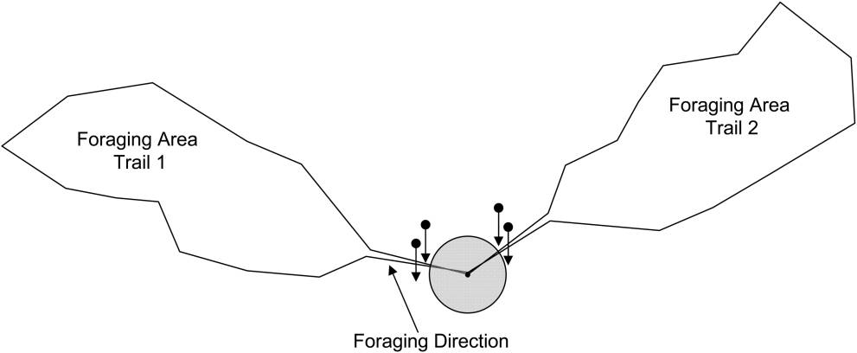
Foraging Path Determination
INSERT IMAGE OF OUR PROGRAM HERE – show the orange patrolling paths (perhaps we need two slides…)
Image taken from
Greene, Michael J. and Gordon, Deborah M. How Patrollers Set Foraging Direction In Harvester Ants. The American Naturalist. Vol 170, no.6 December, 2007.

Slide 8
Forager Recruitment in Inactive Ants
We cannot measure inactive ants
Foragers (sometimes) recruit from inactive ants
INSERT IMAGE OF OUR PROGRAM HERE – show the cross between inactive ants and foragers.

Slide 9
Immediate Future Work
Extend interactions to nest maintenance and brood care.
Scale world to relative colony size.
Simulate Deborah Gordon’s “disturbance” experiments to see if we get similar results

Slide 10
Distant Future Work
Simulate the colony’s behavior over multiple days
Treating a colony as a single organism, simulate multiple colonies simultaneously
Finally, building only on basis behaviors from individual ants, simulate multiple colonies over multiple days

Slide 11
Future Applications
Honeybees
Stock Market
Traffic

Slide 12
Acknowledgements
We would like to thank Dr. Deborah Gordon and her associates, whose research we have so frequently borrowed. For more on Dr. Gordon’s work, please see http://www.stanford.edu/~dmgordon/publications.html
We would also like to, once again, thank the Depart of Applied Mathematics at the University of Colorado at Boulder and the MCTP for their ongoing support of this project.
Finally, we’d like to thank Adam for his continued dedication to our education.

